Slide 1
ANIMAL KINGDOM

Slide 2
ANIMALS?

Slide 3
CLASSIFICATION OF ANIMAL KINGDOM
PHYLUM: PORIFERA
PHYLUM: CNIDARIA OR COELENTRATA
PHYLUM: CTENOPHORA
PHYLUM: PLATYHELMINTHES
PHYLUM: ASCHELIMNTHES
PHYLUM: ANNELIDA
PHYLUM: ARTHROPODA
PHYLUM : MOLLUSCA
PHYLUM : ECHINODERMATA
PHYLUM: HEMICHORDATA
PHYLUM : CHORDATA

Slide 4
BASIS OF CLASSIFICATION
LEVEL OF ORGANISATION
SYMMETRY
EMBRYONIC OR GERMINAL LAYERS
COELOM
SEGMENTATION
NOTOCHORD

Slide 5
LEVEL OF ORGANISATION
CELLULAR LEVEL :

Slide 6
TISSUE LEVEL :

Slide 7
ORGAN LEVEL :

Slide 8
ORGAN SYSTEM LEVEL:

Slide 9
Digestive system
INCOMPLETE
COMPLETE

Slide 10
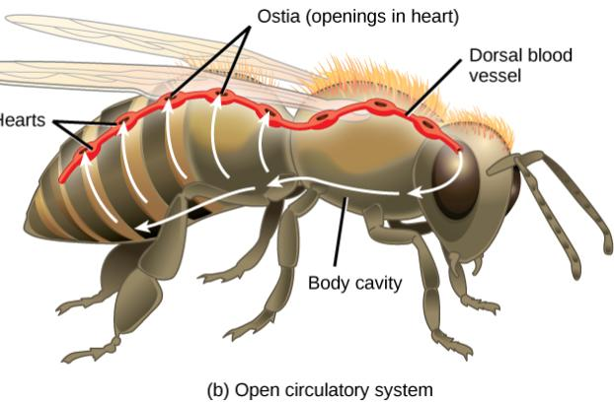
CIRCULATORY SYSTEM
OPEN TYPE

Slide 11
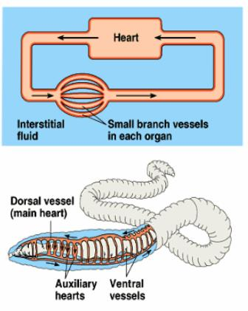
CLOSED TYPE

Slide 12
SYMMETRY

Slide 13
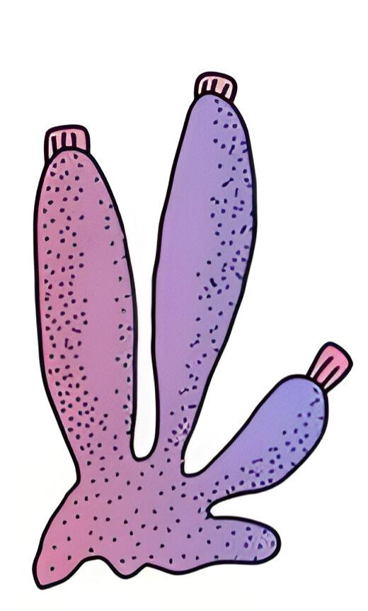
1) ASYMMETRY

Slide 14
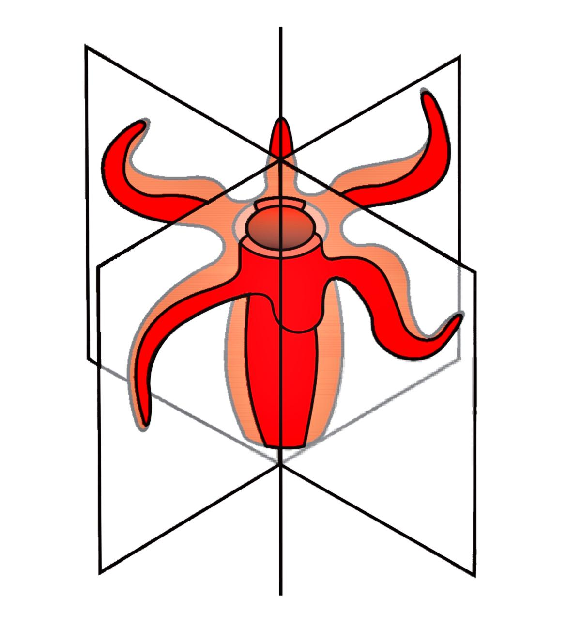
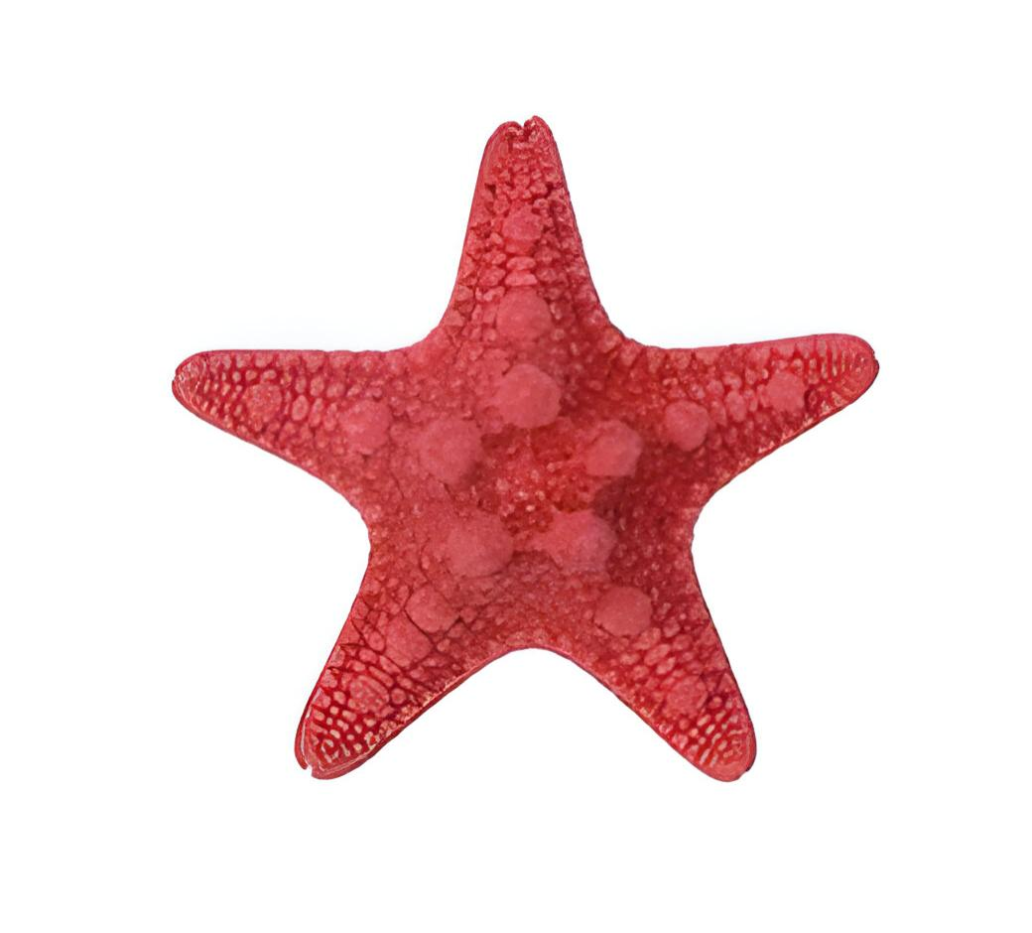
2) RADIAL SYMMETRY

Slide 15
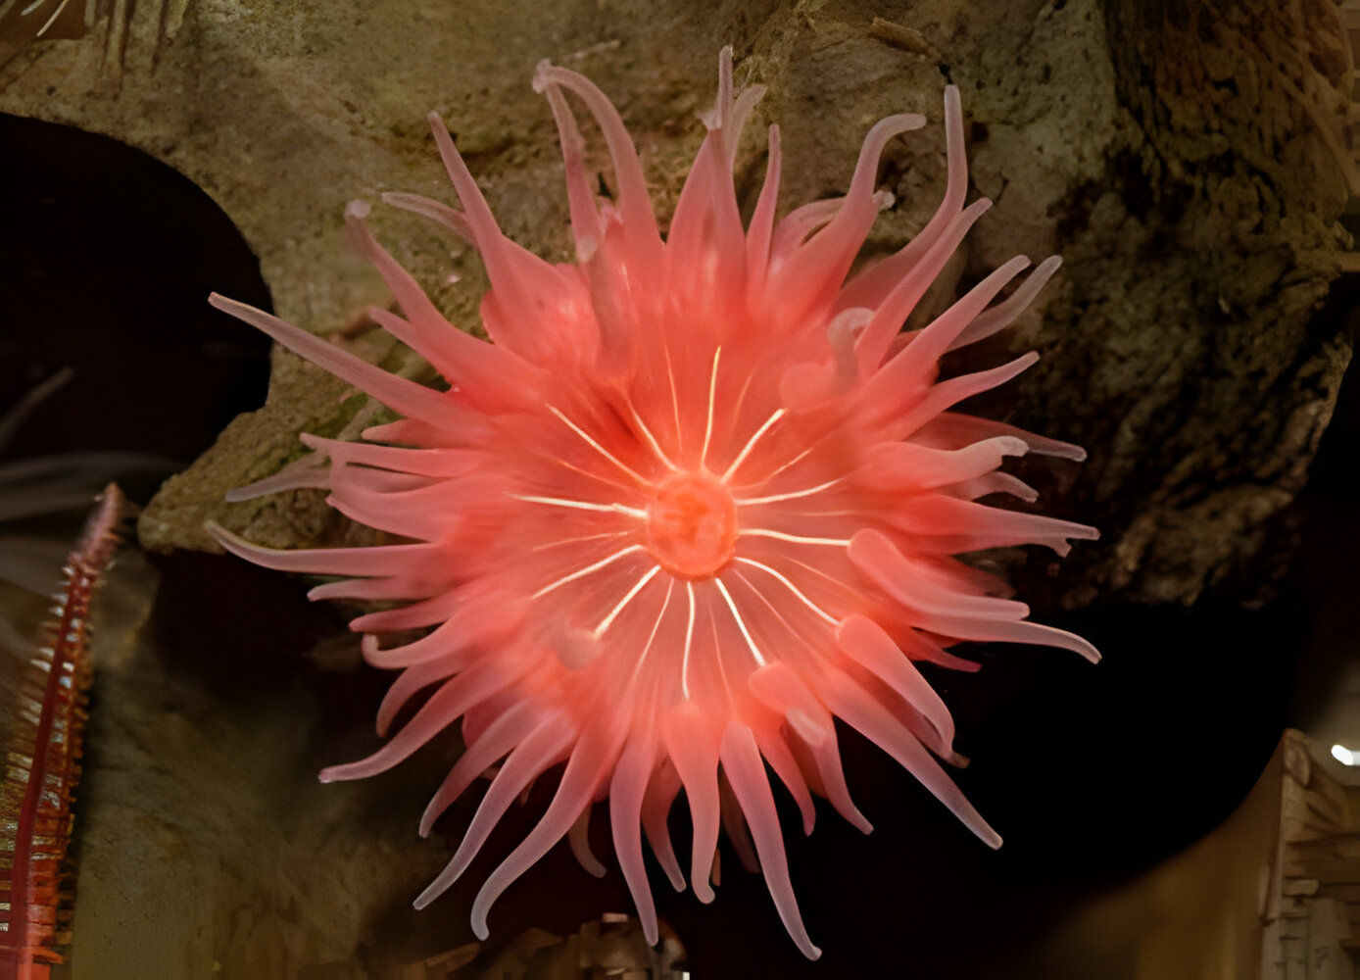

Slide 16
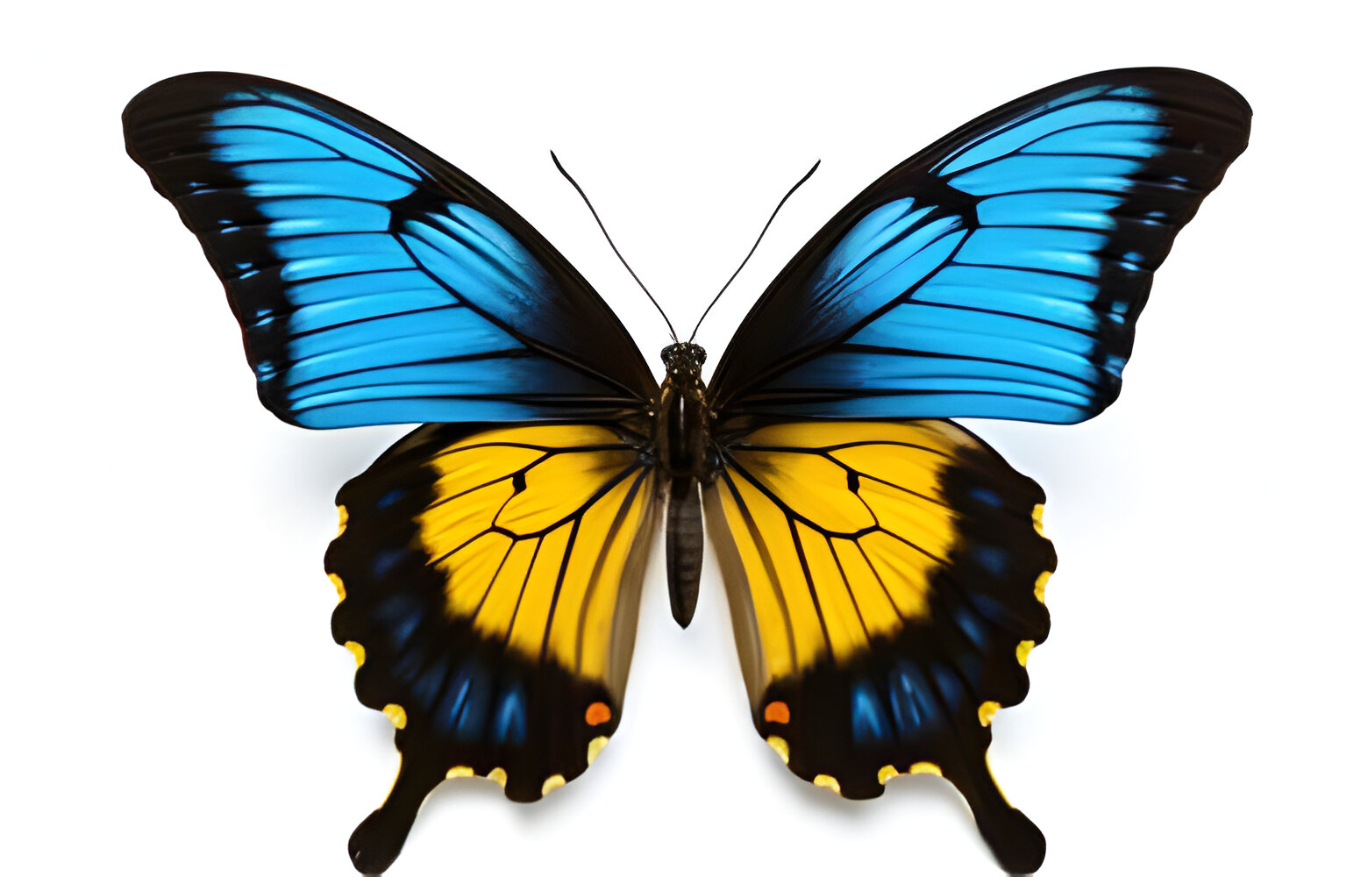
3) BILATERAL SYMMETRY

Slide 18
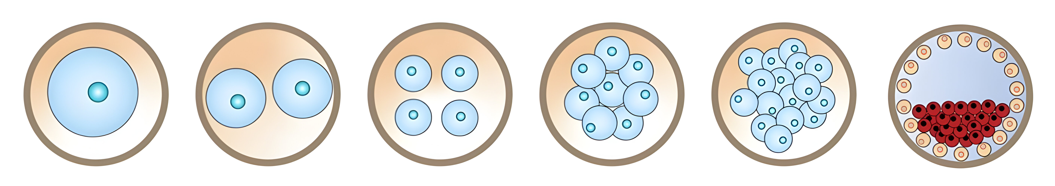
EMBRYONIC LAYERS

Slide 19
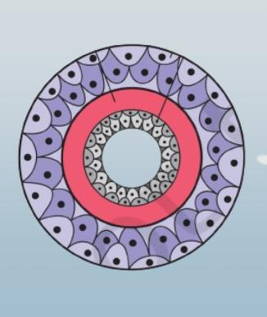
1) DIPLOBLASTIC ANIMALS

Slide 20
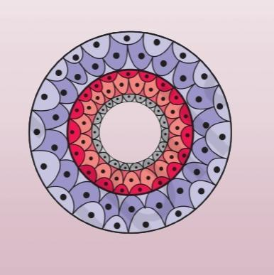
2) TRIPLOBLASTIC ANIMALS

Slide 22
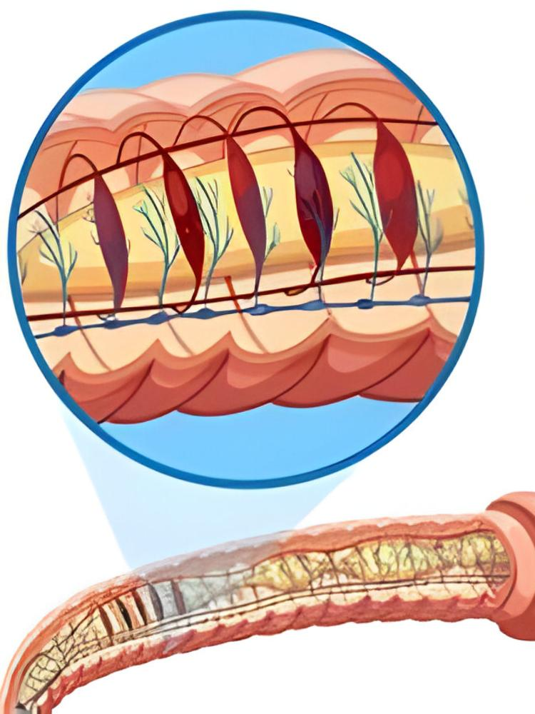
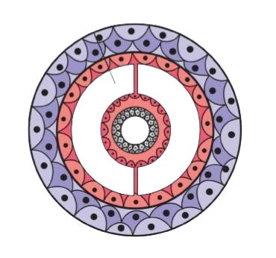
COELOM

Slide 23
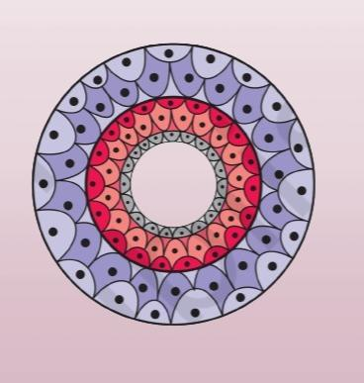
1) ACOELOMATES

Slide 24
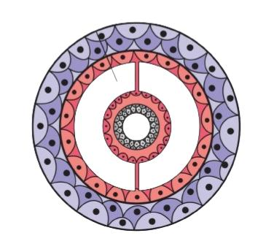
2) COELOMATES

Slide 25
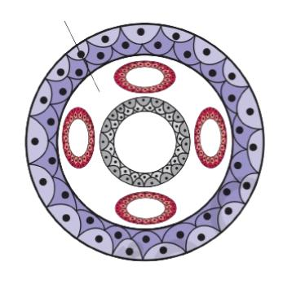
3) PSEUDOCOELOMATES

Slide 26
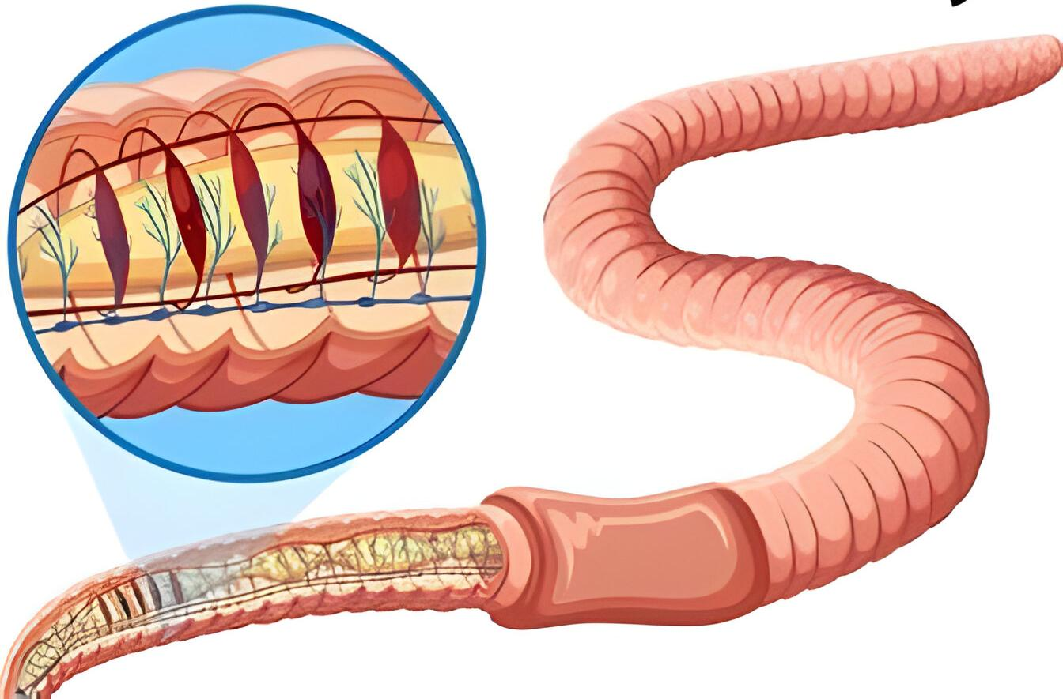
SEGMENTATION
METAMERISM:

Slide 27
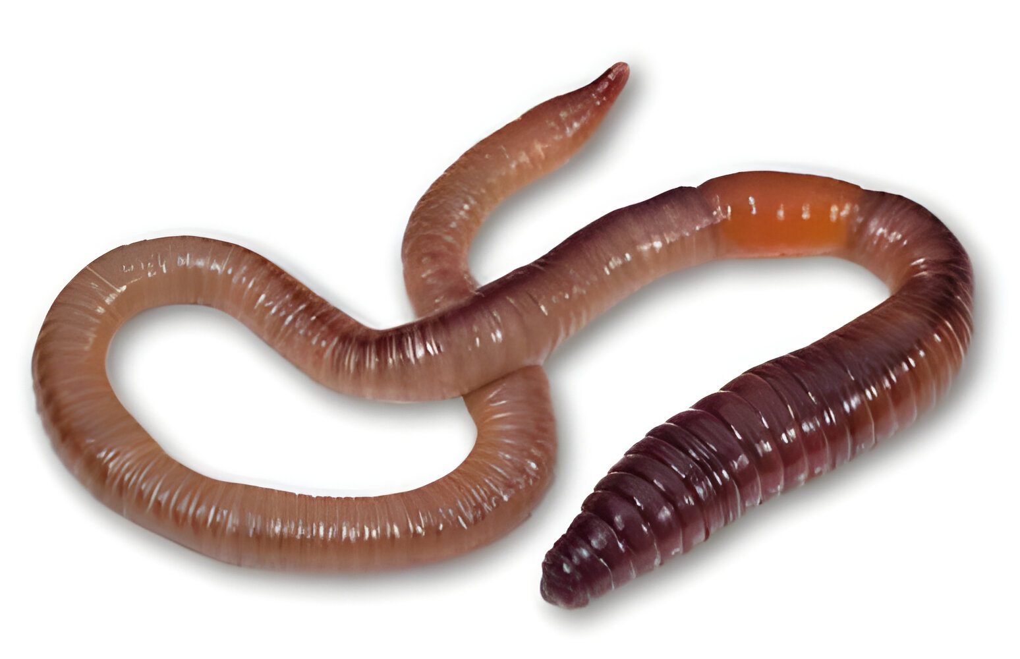
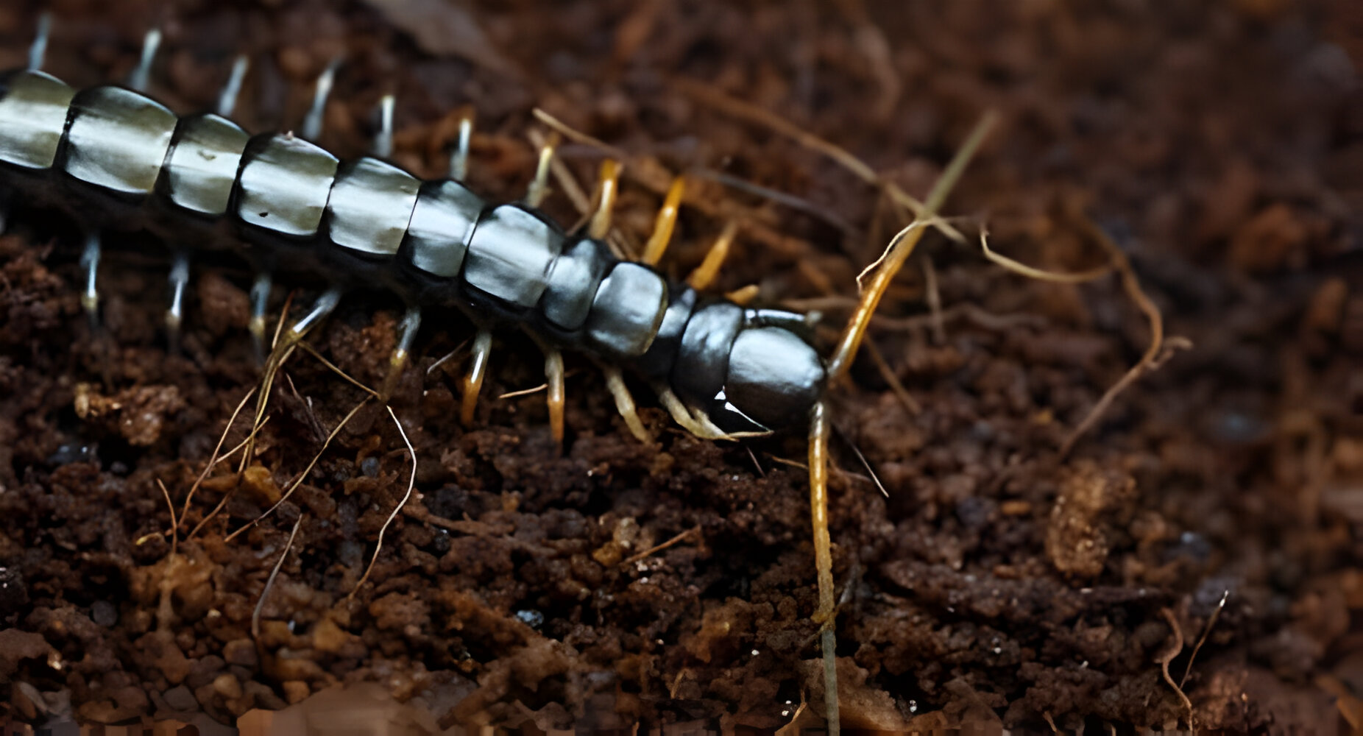
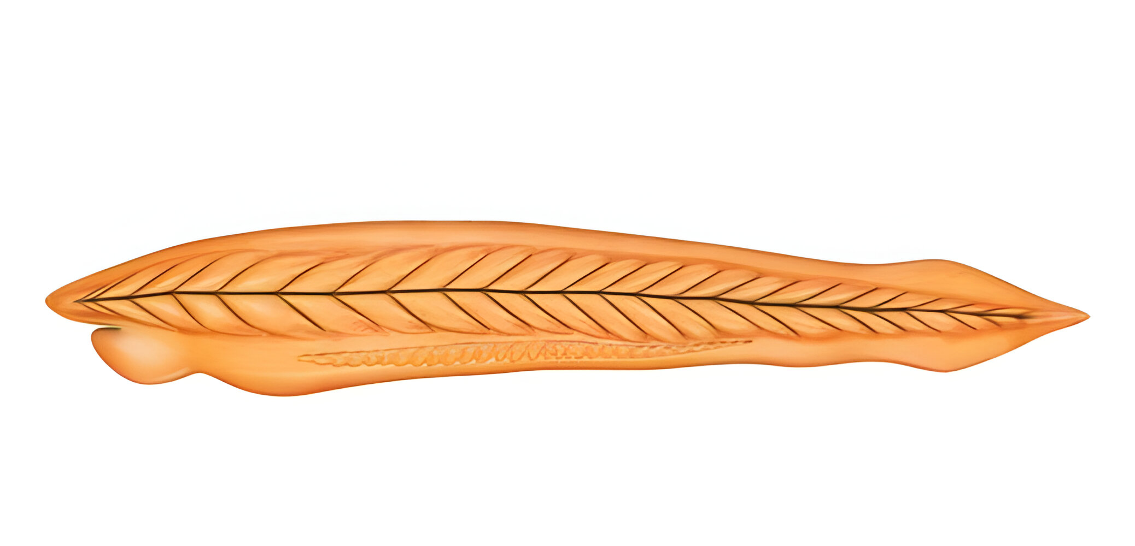

Slide 28
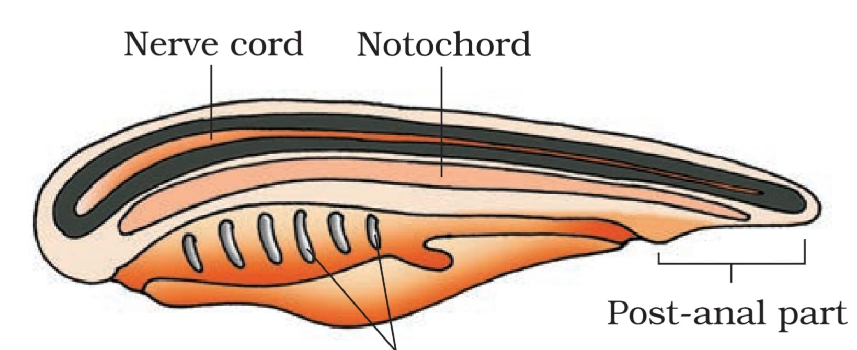
NOTOCHORD

Slide 29
Class discussion
1. Level of organization in porifera is
1. Cellular 2. Tissue 3. Organ 4. Organ System
2. Incomplete digestive tract found in –
1. Platyhelminthes and Aschelminthes
2. Platyhelminthes and Ctenophora
3. Aschelminthes and Annelida
4. Coelenterates and Aschelminthes
3. In diploblastic animals:
1. Mesoderm and mesoglea both are absent
2. Mesoderm is present but mesoglea is absent
3. Mesoderm is absent but mesoglea is present
4. Mesoderm and mesoglea both are present

Slide 30
4. Mesoderm is present as scattered pouches in between the ectoderm and endoderm in
1. Annelids 2. Echinoderms 3. Molluscs 4.Aschelminthes
5. Which of the following statement is not true?
1. All members of the kingdom Animalia are multicellular
2. Nature of coelom is used as one of the bases of animal classification
3. There is no need of classification now as over a million species of animals have been described till now
4. The arrangement of cells in the body is one of the classifying feature of the animals

Slide 31
6. Which one of the following phyla is correctly matched with its general characteristics?
1. Porifera – Cellular level of organization and external fertilization
2. Coelenterate – Diploblastic and mostly Asymmetric
3. Aschelminths – Pseudocoelomates and dioecious
4. Hemichordates – Coelomates and closed circulatory system

Slide 32
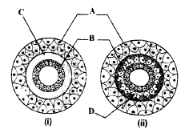
7. Examine the figures of diploblastic
(i) and triploblastic
(ii) organization in animals given below and identify the labelled parts A to D
 | A | B | C | D
1 | Mesoglea | Ectoderm | Endoderm | Mesoderm
2 | Endoderm | Mesoderm | Mesoglea | Ectoderm
3 | Mesoderm | Mesoglea | Ectoderm | Endoderm
4 | Ectoderm | Endoderm | Mesoglea | Mesoderm

Slide 33
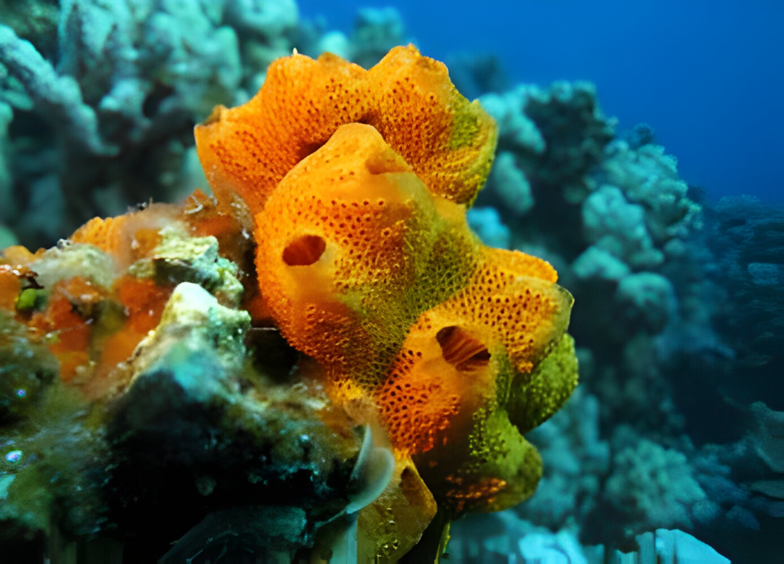
PHYLUM: PORIFERA
(PORE-BEARING)

Slide 34
HABIT AND HABITATE

Slide 35
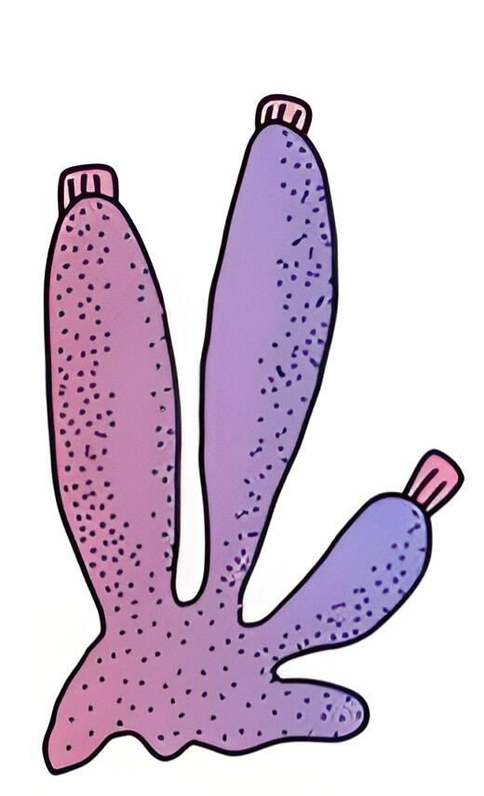
BASIC FEATURES

Slide 37
UNIQUE FEATURES
Porous body

Slide 38
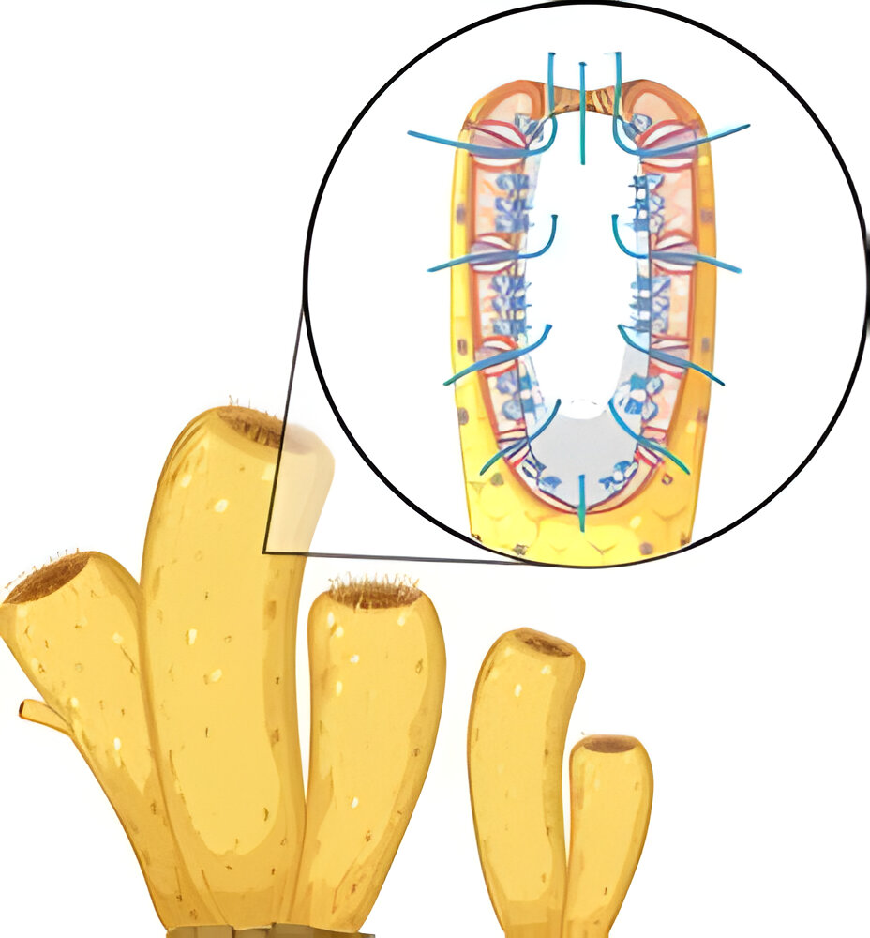
Spongocoel and osculum

Slide 39
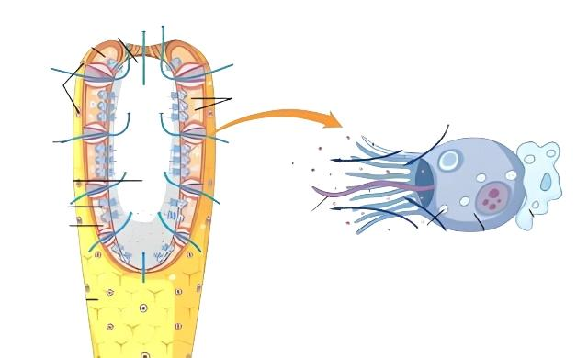
Choanocyte or collar cells

Slide 40
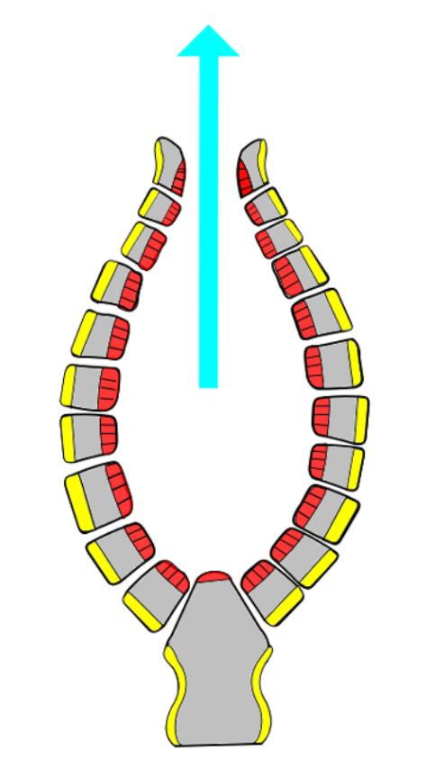
WATER CANAL OR TRANSPORT SYSTEM:

Slide 42
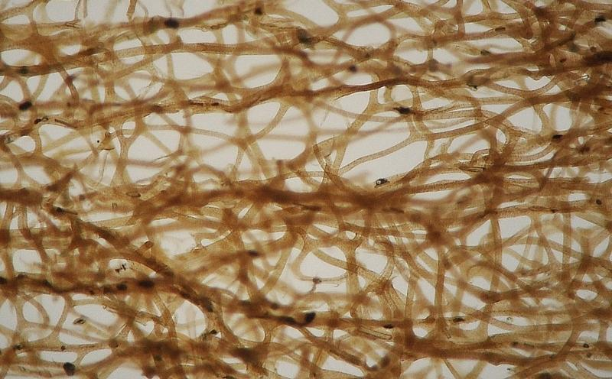
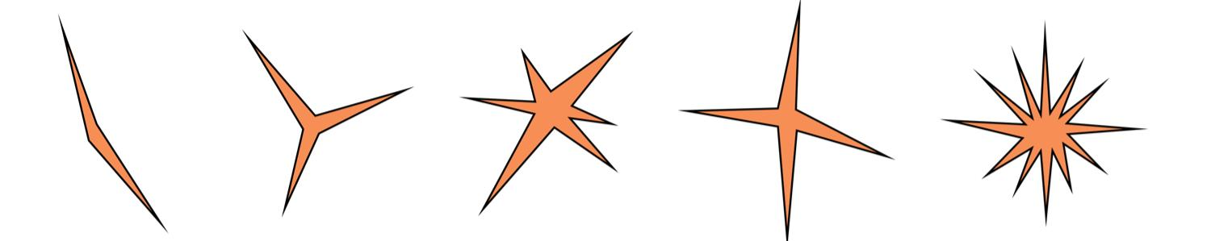
SUPPORTING STRUCTURES: Spicules and spongin fibers

Slide 43
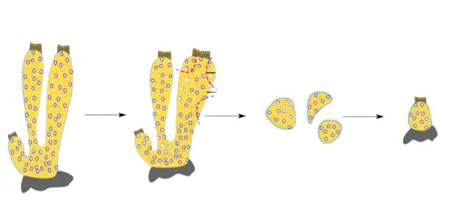
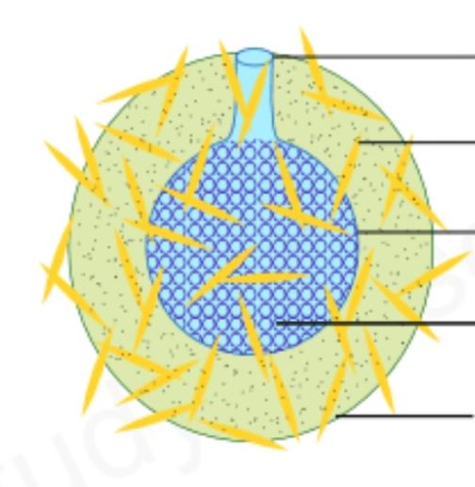
REPRODUCTION
ASEXUAL :

Slide 44
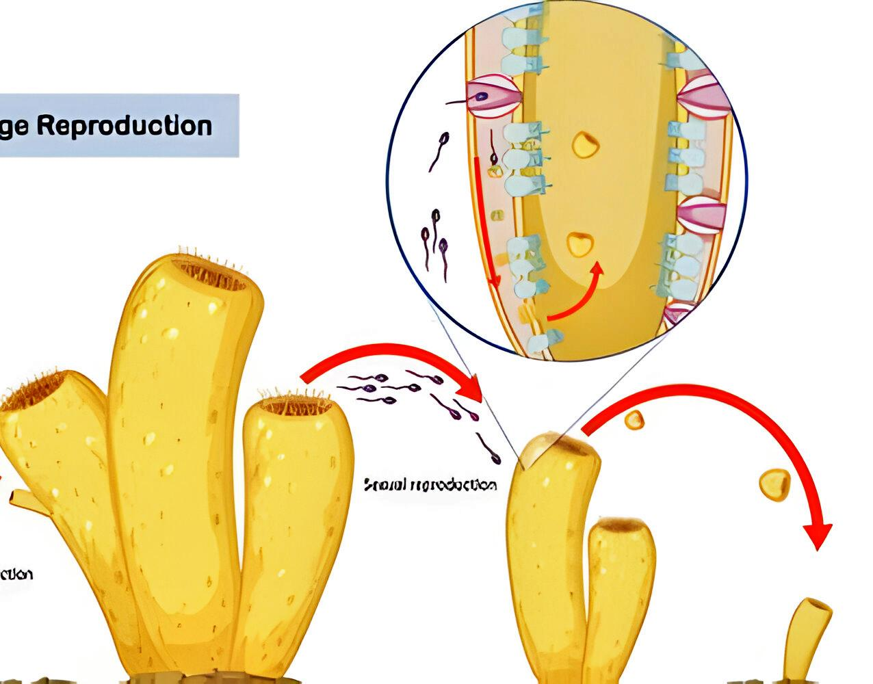
SEXUAL

Slide 46
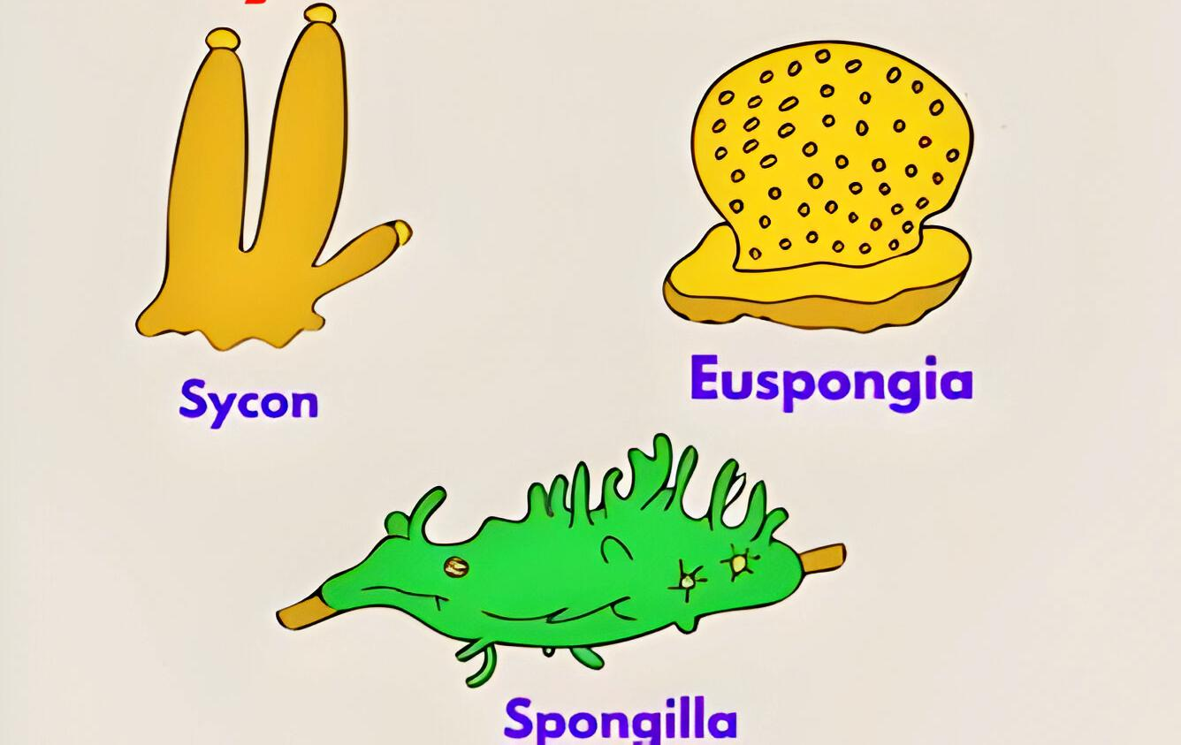
EXAMPLES

Slide 48
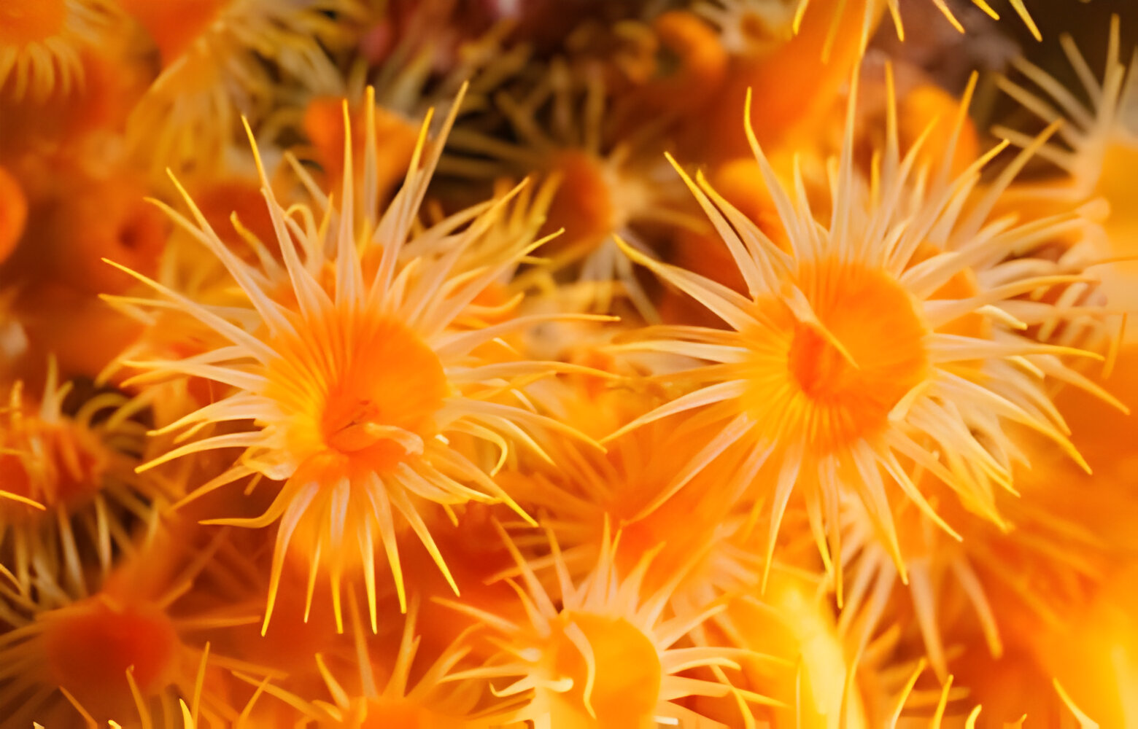
CNIDARIA OR COELENTERATA

Slide 49
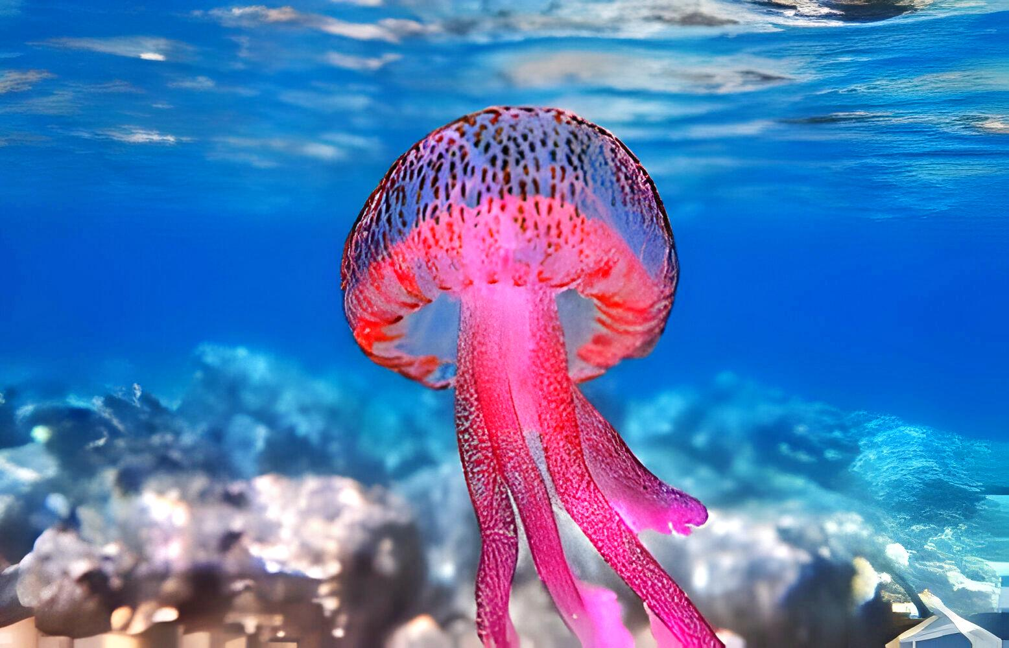
HABIT AND HABITATE

Slide 50
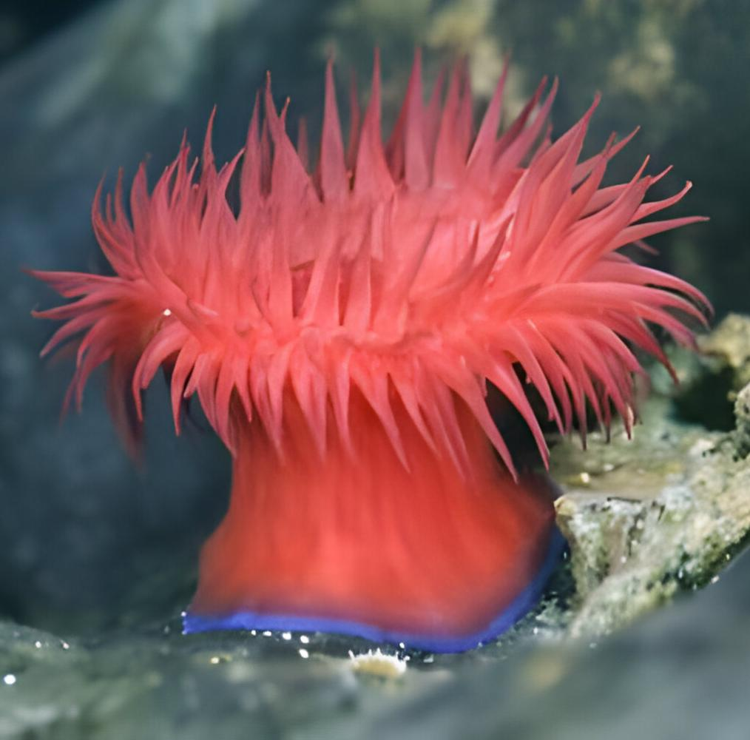
BASIC FEATURES

Slide 52
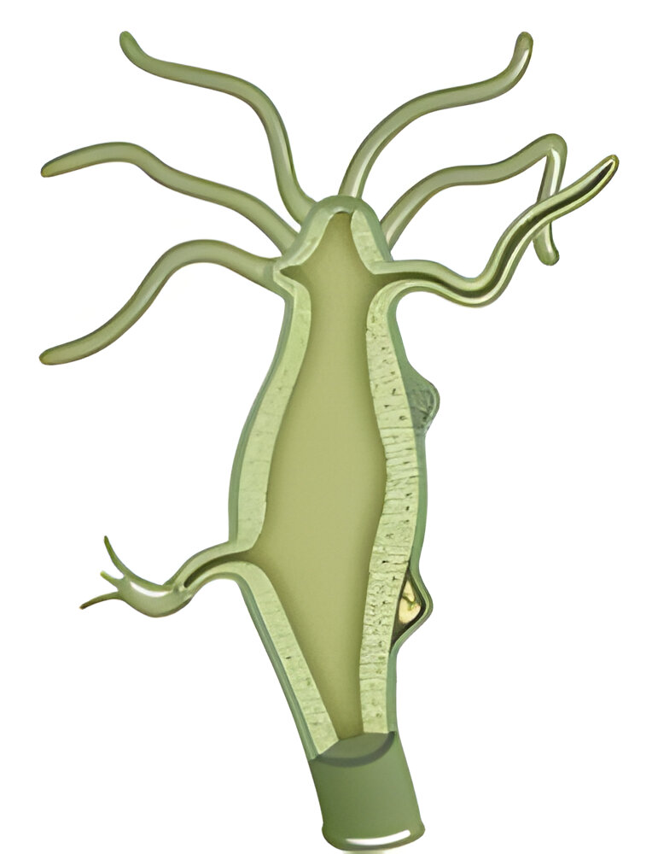
UNIQUE FEATURES
GASTRO-VASCULAR CAVITY

Slide 53
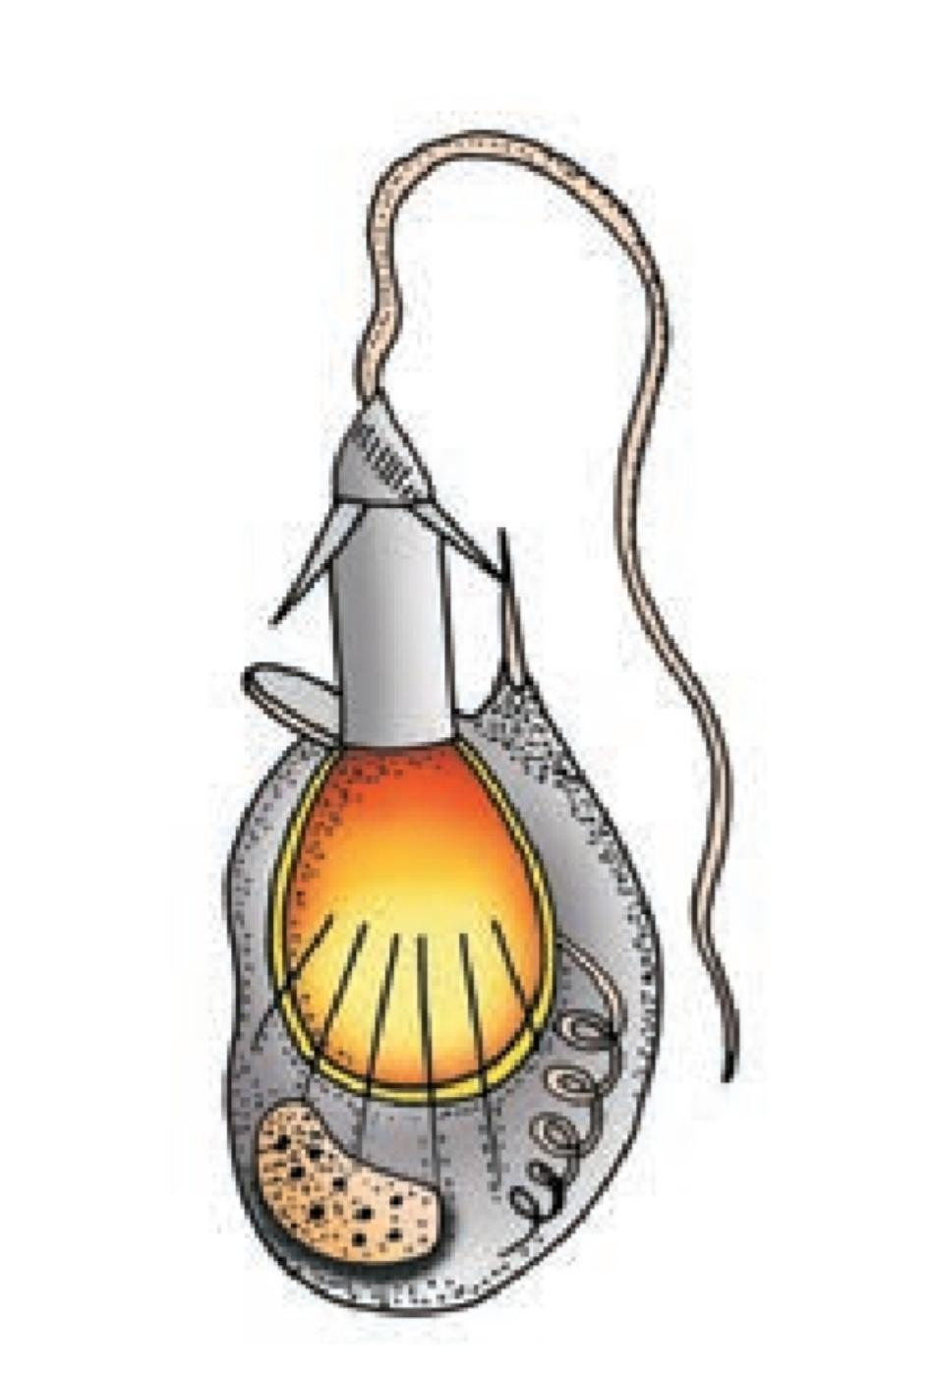
CNIDOBLAST AND NEMATOCYTE

Slide 54
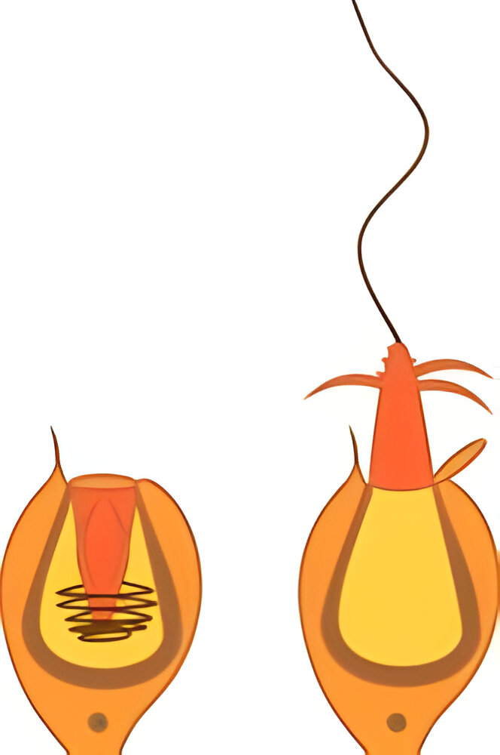

Slide 55
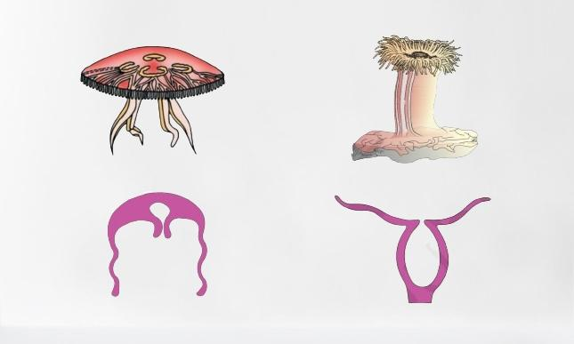
BODY FORMS : Polyp and medusa

Slide 58
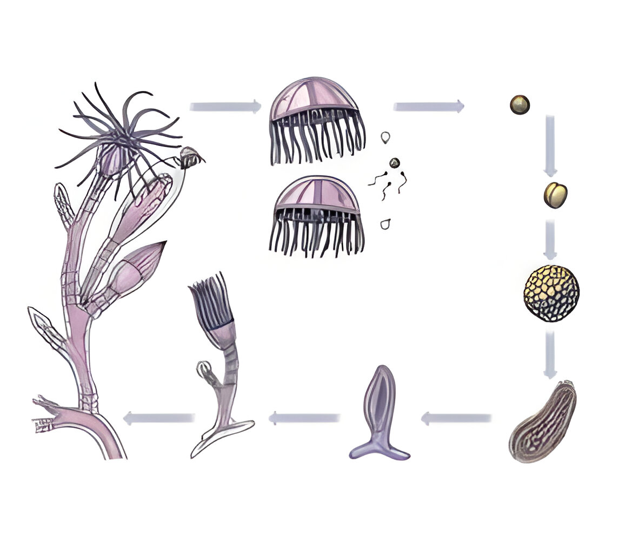
METAGENESIS

Slide 60
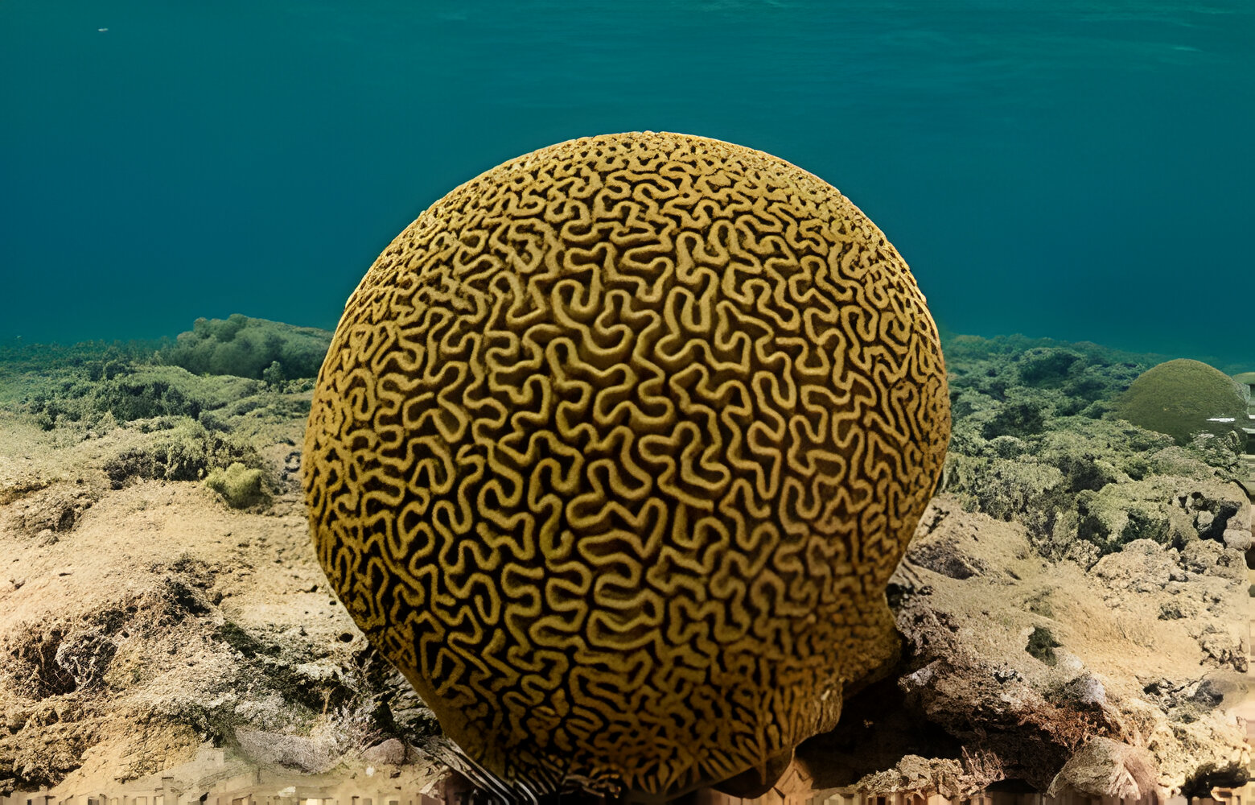
CORALS – BODY WALL

Slide 61
REPRODUCTION

Slide 62
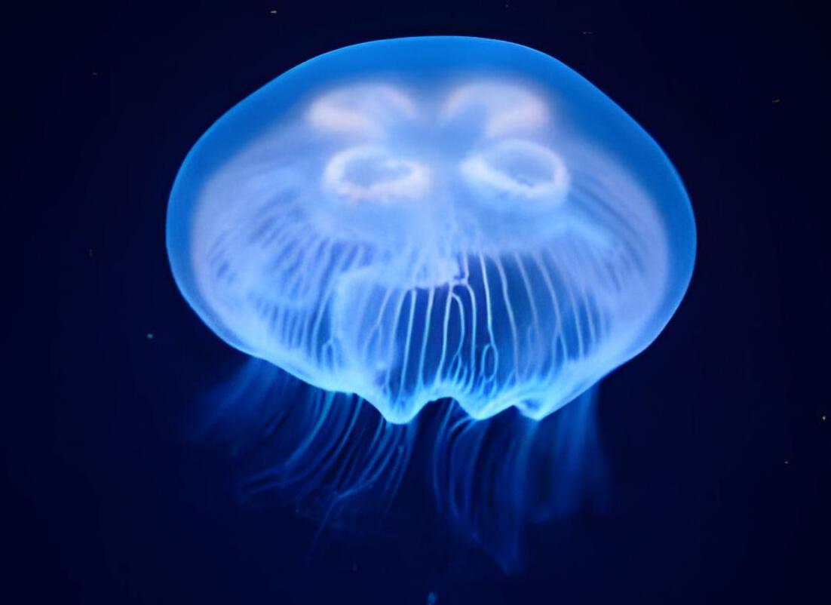
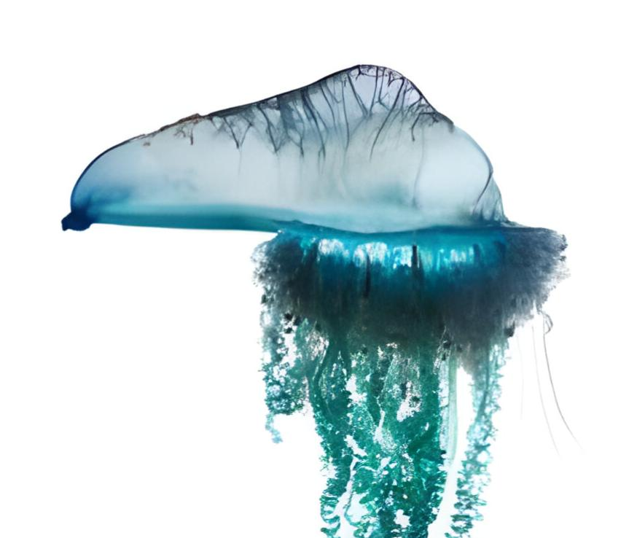
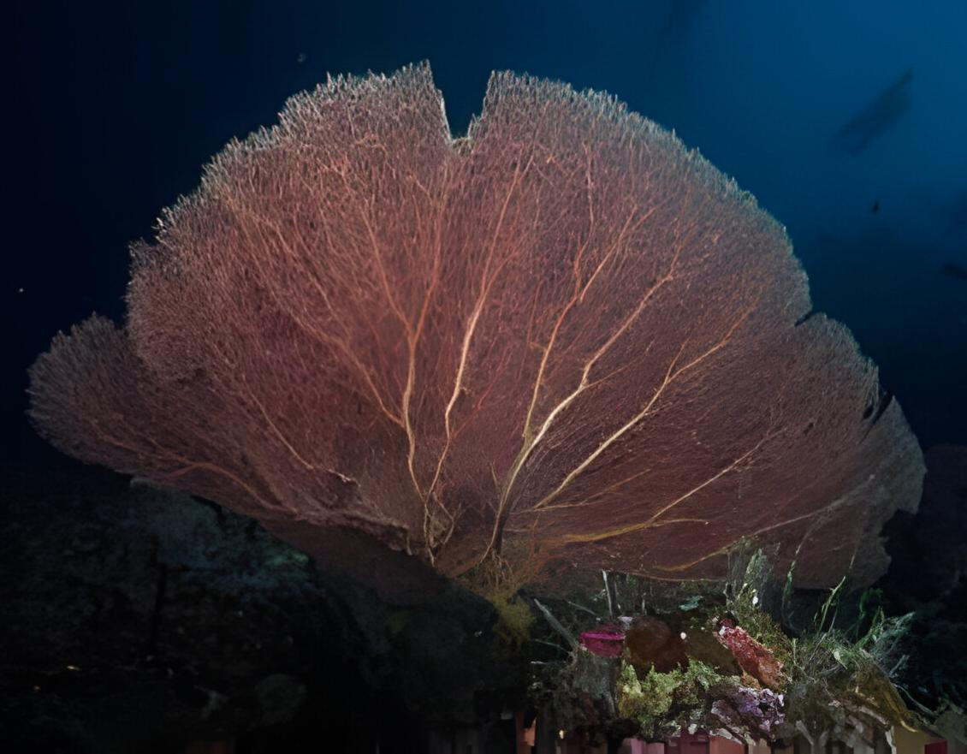
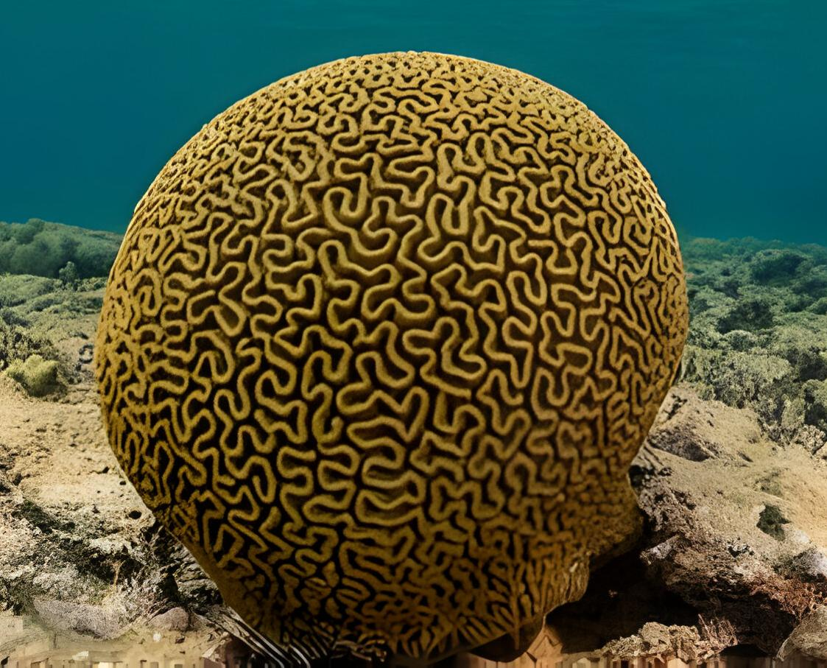
EXAMPLES
Aurelia
Physalia
Gorgonia
Meandrina

Slide 63
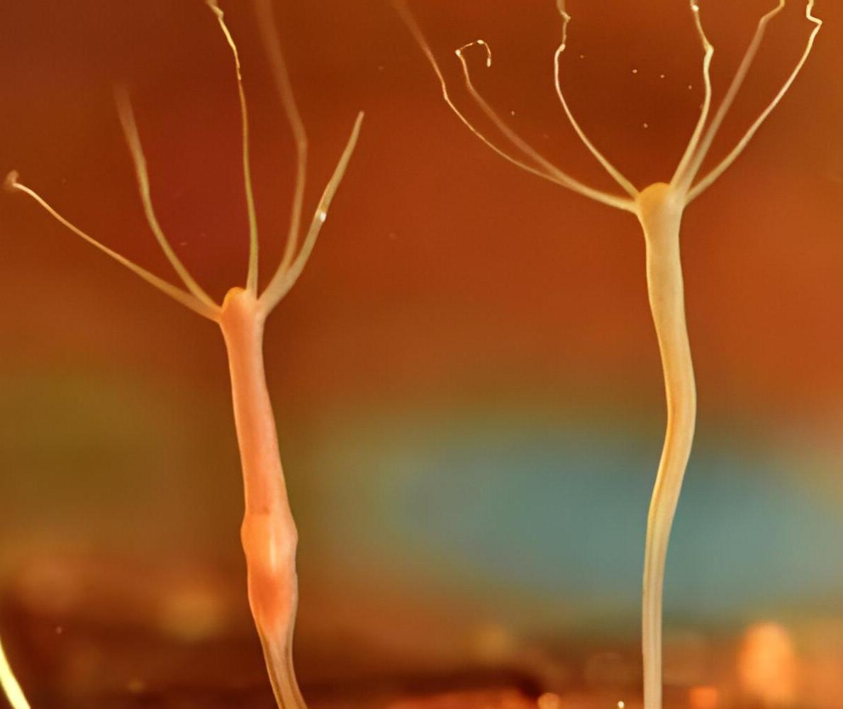
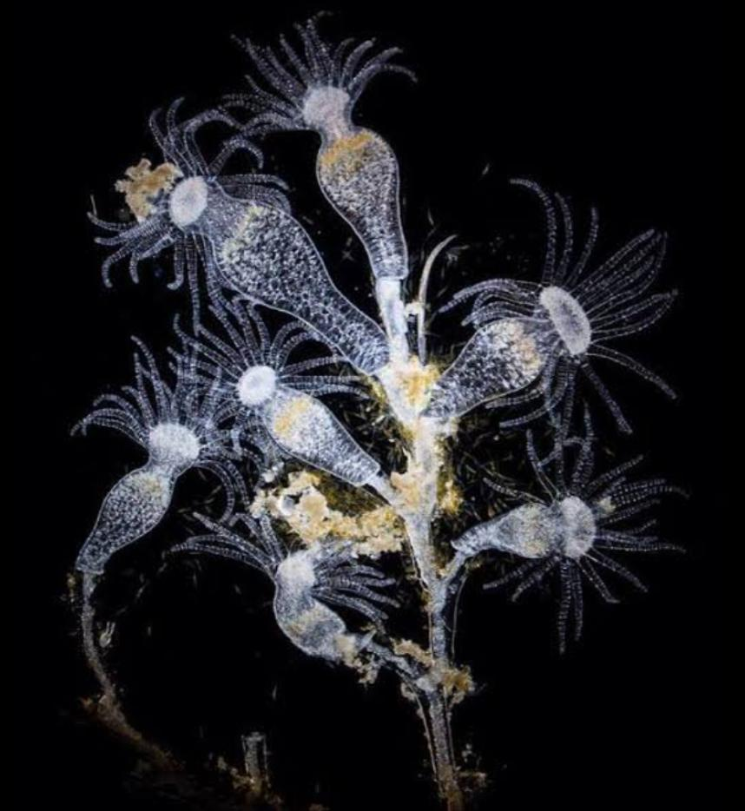
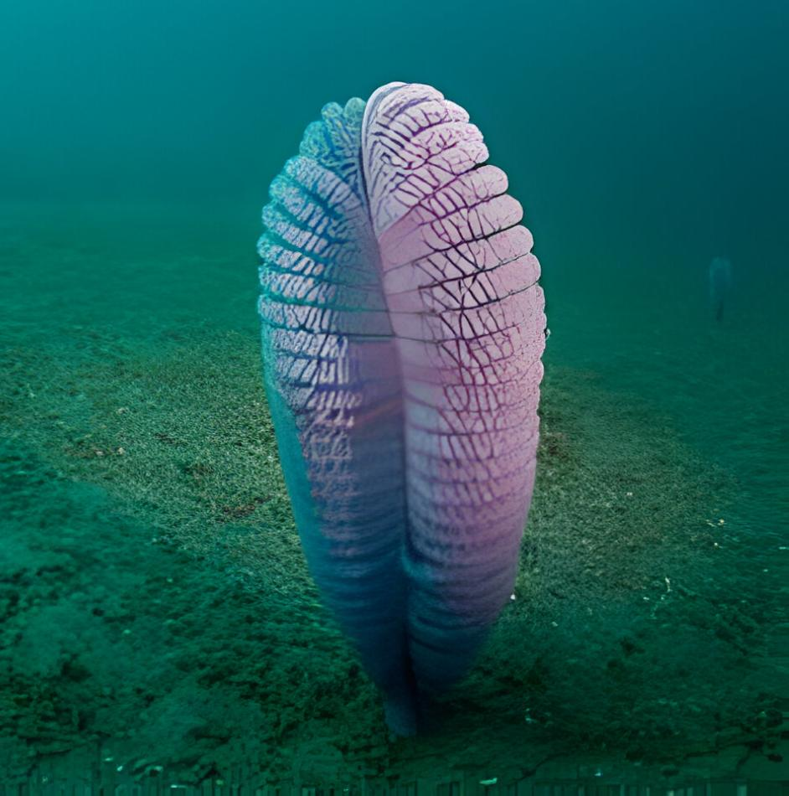
Adamsia
Hydra
Obelia
Aurelia

Slide 65
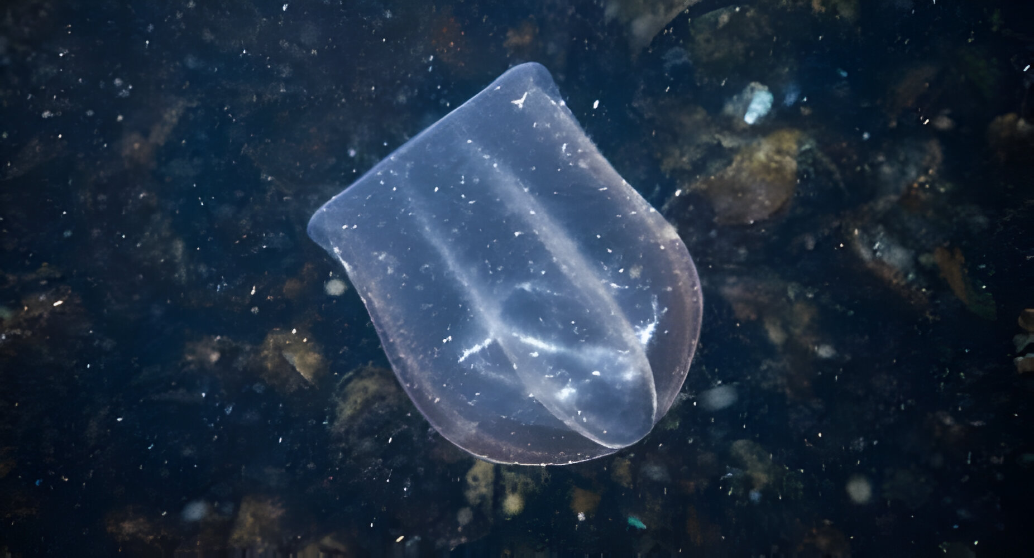
PHYLUM : CTENOPHORA
COMB JELLIES OR SEA WALNUTS

Slide 66
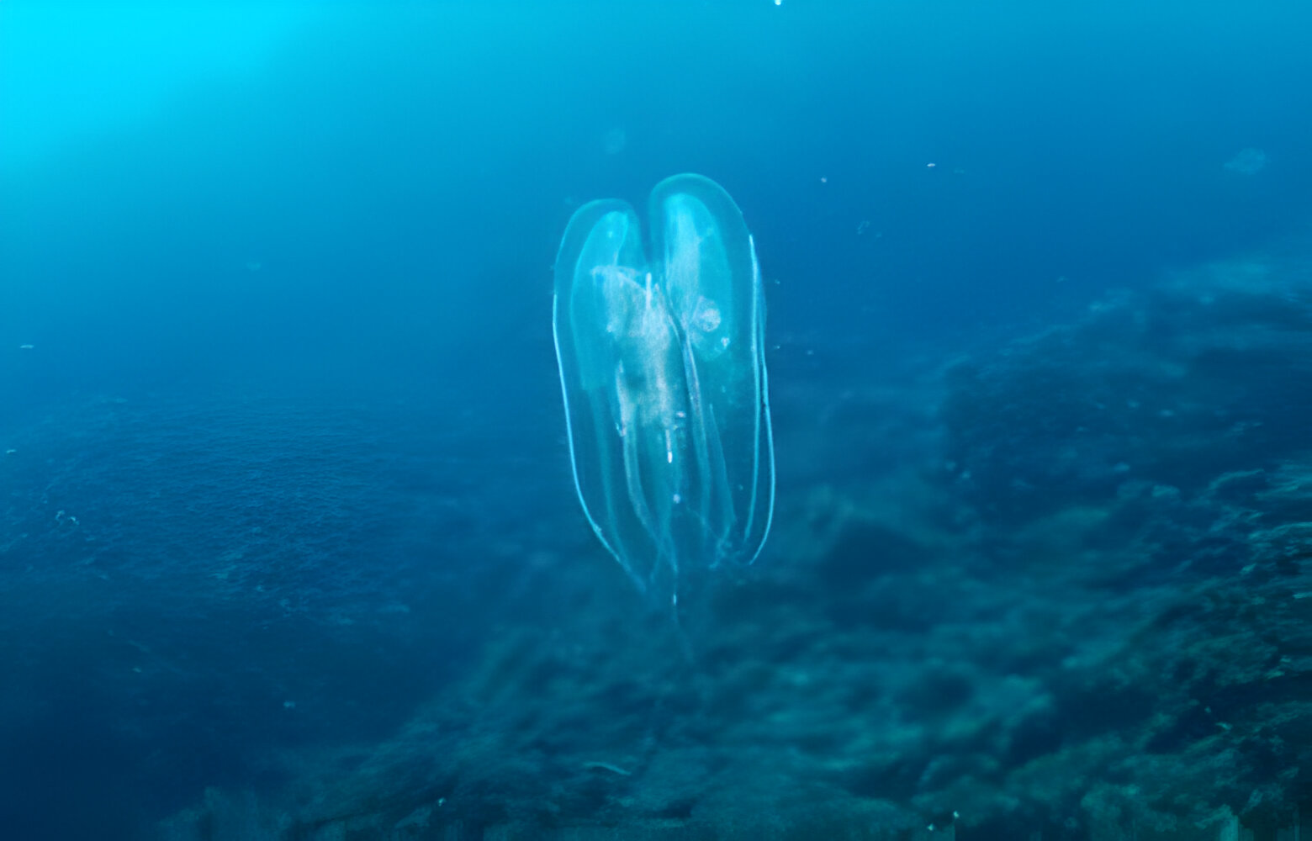
HABIT AND HABITATE

Slide 67
BASIC FEATURES

Slide 69

UNIQUE FEATURES
CILIATED COMB PLATES

Slide 70


Slide 71

BIOLUMINESCENCE

Slide 72
REPRODUCTION

Slide 74


EXAMPLES
Pleurobrachia
Ctenoplana

Slide 76

PHYLUM : PLATYHELMINTHES
FLAT WORMS

Slide 77


HABIT AND HABITATE

Slide 78

BASIC FEATURES

Slide 81

UNIQUE FEATURES
Dorso – Ventraly flattened body

Slide 82

PARASITIC ADAPTATIONS : Hooks and suckers

Slide 83

EXRETORY SYSTEM: Protonephridia with flame cells

Slide 84

NERVOUS SYSTEM

Slide 86

REGENERATION

Slide 88
REPRODUCTION

Slide 90


EXAMPLES
Taenia
Fasciola
Planaria

Slide 91


Slide 92

PHYLUM : ASCHELMINTHES
ROUNDWORMS

Slide 93
HABIT AND HABITATE

Slide 95
BASIC FEATURES

Slide 97


UNIQUE FEATURES

Slide 98

EPIDERMIS AND CUTICLE

Slide 99


DIGESTIVE SYSTEM

Slide 100
EXCRETORY SYSTEM

Slide 101

SEXUAL DIMORPHISM

Slide 102


Slide 103
REPRODUCTION

Slide 105



EXAMPLES
Ascaris
Ancylostoma
Whucheraria

Slide 106

PHYLUM : ANNELIDA
RINGED WORM

Slide 107
HABIT AND HABITAT

Slide 109
BASIC FEATURES

Slide 111



UNIQUE FEATURES
METAMERICALLY SEGMENTED BODY

Slide 113

CIRCULATORY SYSTEM

Slide 114
EXRETORY ORGAN

Slide 115

LOCOMOTORY STRUCTURES : MUSCLES AND SETAE

Slide 116

LOCOMOTORY STRUCTURES : PARAPODIA

Slide 117

REPRODUCTION

Slide 119



EXAMPLES
Pheretima
Hirudinaria
Neries

Slide 120


Slide 121

PHYLUM : ARTHROPODA
LARGEST PHYLUM
ARTHRO – JOINTED ; PODA- APPENDAGES

Slide 122
HABIT AND HABITAT

Slide 123
BASIC FEATURES

Slide 125


UNIQUE FEATURES
JOINTED APPENDAGES

Slide 126

UNIQUE FEATURES
BODY DIVISIONS

Slide 127

UNIQUE FEATURES
CHITINOUS EXOSKELETON

Slide 128


UNIQUE FEATURES
CIRCULATORY SYSTEM

Slide 129
EXRETORY ORGANS
Malpighian tubules
Green / Antennal gland

Slide 130
RESPIRATORY ORGANS
Tracheal system
Book lungs
Book gills
Gills

Slide 132
NERVOUS SYSTEM

Slide 133


UNIQUE FEATURES
SENSORY ORGANS

Slide 135
REPRODUCTION

Slide 136

EXAMPLES

Slide 137



Economically important Insects

Slide 138

VECTORS
Mosquitoes

Slide 139

Gregarious pest
Locusta

Slide 140

Living fossils
Limulus

Slide 141

PHYLUM : MOLLUSCA
Second LARGEST PHYLUM
SOFT BODIED ANIMAL

Slide 142


HABIT AND HABITAT

Slide 143
BASIC FEATURES

Slide 145

UNIQUE FEATURES
SOFT UNSEGMENTED BODY, USUALY COVERED BY CALCAREOUS SHELL

Slide 146


UNIQUE FEATURES
BODY DIVISIONS
Head
Muscular foot
Visceral mass/ hump

Slide 147
UNIQUE FEATURES
MANTLE AND MANTLE CAVITY

Slide 148

UNIQUE FEATURES
RESPIRATION AND EXCRETION

Slide 149

UNIQUE FEATURES
CIRCULATORY SYSTEM

Slide 150

UNIQUE FEATURES
RADULA

Slide 152

REPRODUCTION

Slide 153
EXAMPLES

Slide 154
Sepia
Aplysia
Loligo
Octopus

Slide 155
Pila
Chaetopleura
Pinctada
Dentalium

Slide 158
PHYLUM : ECHINODERMATA
Spiny bodied animals

Slide 159
HABIT AND HABITAT

Slide 160
BASIC FEATURES

Slide 162
UNIQUE FEATURES
SPINY BODY/SKIN,
ENOSKELETON OF CALCAREOUS OSSICLES

Slide 163
UNIQUE FEATURES
Digestive system

Slide 164
UNIQUE FEATURES
WATER VASCULAR SYSTEM

Slide 165
UNIQUE FEATURES
LOCOMOTORY ORGAN

Slide 166
EXCRETORY SYSTEM??

Slide 168
REPRODUCTION

Slide 169
EXAMPLES

Slide 170
Cucumaria
Asterias
Cucumaria
Antedone
Echinus
Ophuira

Slide 172
PHYLUM: HEMICHORDATA
Marine cylindrical worms

Slide 173
SYSTEMATIC POSITION OF HEMICHORDATES

Slide 174
HABIT AND HABITAT

Slide 175
BASIC FEATURES

Slide 176
UNIQUE FEATURES

Slide 177
UNIQUE FEATURES
BODY DIVISIONS

Slide 178
UNIQUE FEATURES
EXCRETORY ORGAN

Slide 179
UNIQUE FEATURES
CIRCULATORY SYSTEM

Slide 180
UNIQUE FEATURES
RESPIRATORY ORGAN

Slide 181
UNIQUE FEATURES
STOMOCHORD

Slide 182
REPRODUCTION

Slide 183
EXAMPLES
Balanoglossus
Saccoglossus

Slide 184
Class discussion- Non chordates
1. The canal system is characteristic feature of-
1. Sponges 2. Helminthes
3. Echinoderms 4. Coelenterates
2. Identify the phylum A and B which are having following set of features:
1. A = Porifera, B = Annelida 2. A = Cnidaria, B = Annelida
3. A = Cnidaria, B = Arthropoda 4. A = Porifera, B = Arthropods
 | Features | Phylum A | Phylum B
A | Symmetry | Radial | Bilateral
B | Metamerism | - | +
C | Metagenesis | + | -
D | Chitinous exoskeleton | - | +

Slide 185
3. Which is the most appropriate term used for the life cycle of Obelia?
1. Polyps produces medusa sexually
2. Metagenesis
3. Alternation of generation and alteration of host (Digenetic)
Monogenetic
4. Which of the following is not a characteristic feature of Fasciola hepatica?
1. Sexes are not separate (hermaphrodite)
2. Fertilization is internal and is cross fertilization
3. Development is indirect through many larval stages
4. Nephridia help in osmoregulation

Slide 186
5. Which of the following is not character of phylum Ctenophora?
1. Exclusively marine and radially symmetrical
2. Diploblastic with tissue level organization
3. Monoecious and exhibit bioluminescence
4. Reproduction is internal with indirect developmen
6. The digestion of food in sponges is
1. Extracellular 2. Intracellular
3. Both intracellular & extracellular
4. Absent
7. Which of the following animals is diploblastic?
1. Penna Tula 2. Paramaecium
3. Taenia Solium 4. Ascaris

Slide 187
8. Comb plates of ctenophores posses
1. Cilia for locomotion 2. Cilia for filter feeding
3. Teeth for crushing 4. Teeth for filtering
9. Which set of animals possess stinging cells?
1. Hydra, Neris 2. Obelia, Aurelia
3. Earthworm, Beroe 4. Ctenoplana, Ascaris
10. Members of phylum Platyhelminthes are known as flat worms because body of these animals:
1. Is bilaterally compressed
2. A flat head present on the anterior end
3. Is dorso-ventrally flat
4. Is dorsolaterally compressed

Slide 188
11. Match the following column
1. A – i, B – iv, C – iii, D – v 2. A – i, B – iv, C – iii, D – v
3. A – i, B – iv, C – iii, D – v 4. A – i, B – iv, C – iii, D – v
12. which of the following belong to phylum-Annelida?
1. Hirudinaria, Nereis and Wuchereia
2. Earthworms, Aphrodite and Pila
3. Pheretima, Hirudinaria and Nereis
4. Aplysia, Nereis and Dentalium
 | Column I |  | Column II
A | Ancylostoma | (i) | Hookworm
B | Wuchereia | (ii) | Filaria worm
C | Ascaris | (iii) | Round worm
D | Fasciola | (iv) | Liver fluke
 |  | (v) | Flatworms

Slide 189
13. Statocysts are the
1. Lateral locomotory appendages in annelids
2. Suckers present in parasitic platyelminthes
3. Balancing organs in arthropods
4. Stinging capsules in cnidarians
14. Which one belongs to Mollusca?
1. Devil Fish 2. Dog Fish 3. Silver Fish 4. Jelly Fish
15. Which of the following set of animals belongs to phylum Echinodermata?
1. Ascaris, Nereis, Echinus
2. Cucumaria, Adamsia, Pinctada
3. Aplysia, Antedon, Limulus
4. Echinus, Asterias, Ophiura

Slide 190
16. The statement which does not stand true for arthropods is
1. They have an open circulatory system
2. Their body is divided into head, thorax and abdomen
3. They are segmented and coelomate animals
4. Fertilization is usually external in them
17. Coelenterates differs from ctenophore because:
1. Coelenterates are only marine while ctenophores are fresh – water as well as marine
2. Ctenophorans are mostly sessile while coelenterates are mostly free floating
3. Ctenophorans swims by the help of cilia while coelenterates do not show such condition
4. Coelenterates only reproduces by sexual mode while ctenophorans shows both sexual and asexual moder of reproduction

Slide 191
18. Radula is
1. Larval form of coelenterates (cnidarians)
2. File like rasping organ of Mollusca
3. Larval form of annelids
4. Uncovered structure present with echinoderms
19. Absence of excretory organs, with water vascular system and exclusively marine animals belongs to the phylum
1. Mollusca 2. Arthropoda 3. Echinodermata 4. Annelida
20. The characters given below are shown by
(i) extracellular and intracellular digestion
(ii) Exclusively marine, radially symmetrical, diploblastic, tissue level of organization
(iii) bisexual, ferritization external and indirect development
(iv) No asexual reproduction
(v) Presence of comb plates
1. Cnidaria 2. Porifera 3. Ctenophora 4. None of these

Slide 192
21. What refers to mantle cavity in a typical Mollusca?
1. Space between shell and foot
2. Space between visceral hump and mantle
3. Space between visceral hump and gut
Space between tentacles and head
22. In which of the following, the genus name, its two characters and its phylum are not correctly matched?
 | Genus Name | Two characters | Phylum
1 | Nereis | Excretion by nephridia Pseudo metamerism | Annelida
2 | Bombyx | Metamerism Respiration by trachea | Arthropoda
3 | Pinctada | Presence of foot Radula | Mollusca
4 | Taenia | Endoparasite Dorsoventrally flattened body | Platyhelminthes

Slide 193
23. Cucumaria is member of phylum Echinodermata.
Symmetry of its larva is expected to be:
1. Asymmetrical 2. Radial
3. Bilateral 4. Spherical

Slide 194
PHYLUM: CHORDATA

Slide 195
BASIC FEATURES

Slide 196
CHORDATE CHARECTORS

Slide 197
CHORDATES V/S NON - CHORDATES

Slide 198
Phylum: Chordata
Sub phylum: Urochordata
Sub phylum : Cephalochordata
Subphylum: Veretbrata
CLASSIFICATION OF CHORDATES

Slide 199
SUBPHYLUM: UROCHORDATA
TUNICATES

Slide 200
FEATURES

Slide 201
EXAMPLES
Ascidia
Salpa
Dolliolum

Slide 202
SUBPHYLUM: CEPHALOOCHORDATA

Slide 203
FEATURES

Slide 204
EXAMPLE : Branchiostoma

Slide 205
SUBPHYLUM: VERTEBRATA

Slide 206
FEATURES

Slide 207
FEATURES

Slide 208
CLASSIFICATION OF VERTEBRATES

Slide 209
CLASS: CYCLOSTOMATA

Slide 210
HABIT AND HABITATE

Slide 211
FEATURES
ELONGATED BODY WITH 6-12 PAIRS OF GILL SLITS

Slide 212
FEATURES
SCALES AND FINS??

Slide 213

FEATURES
MOUTH AND JAW…

Slide 214

FEATURES
CIRCULATION AND THERMO REGULATIONS

Slide 215
ENDOSKELETON AND NOTOCHORD

Slide 216
MIGRATION OF LAMPREYS

Slide 217


EXAMPLES
Myxine
Peteromyzone

Slide 218


Slide 219

CLASS:CHONDRICTHYES
CARTILAGE FISHES

Slide 220

Habit and habitat
Marine fishes
PREDACEOUS

Slide 221

FEATURES
MOUTH AND JAW BONE

Slide 222


FEATURES
SCALES AND TEETH

Slide 223


FEATURES
GILLS AND OPERCULUM

Slide 224
FEATURES
AIRBLADDER??

Slide 225

FEATURES
CLASPERS IN MALE

Slide 226

FEATURES
HEART AND THERMOREGULATIONS

Slide 227
ENDOSKELETON AND NOTOCHORD

Slide 228
REPRODUCTION

Slide 229




EXAMPLES

Slide 230


Slide 231

CLASS:OSTEICTHYES
BONY FISHES

Slide 232


Habit and habitat
marine AND FRESH WATER

Slide 233

ENDOSKELETON

Slide 234

FEATURES
MOUTH

Slide 235

FEATURES
SCALES

Slide 236

FEATURES
GILLS AND OPERCULUM

Slide 237

FEATURES
AIRBLADDER

Slide 238
FEATURES
HEART AND THERMOREGULATIONS

Slide 239
REPRODUCTION

Slide 240


EXAMPLES
Marine

Slide 241

EXAMPLES
Fresh water

Slide 242

EXAMPLES
Aquarium

Slide 243


Slide 244

CLASS:AMPHIBIA

Slide 245

Habit and habitat
DUAL MODE OF LIFE

Slide 246


FEATURES
BODY DIVISIONS

Slide 247


FEATURES
Skin

Slide 248

FEATURES
HEAD WITH TYMPANUM

Slide 249

FEATURES
TRUNK WITH LIMBS

Slide 250

FEATURES
RESPIRATION

Slide 251

FEATURES
CLOACA

Slide 252

FEATURES
HEART AND THERMOREGULATION

Slide 253
REPRODUCTION

Slide 254


Examples

Slide 255

CLASS:REPTILIA

Slide 256

Habit and habitat
Terrestrial
Creep or crawling mode of locomotion

Slide 257



FEATURES
SkiN

Slide 258
FEATURES
BODY DIVISIONS

Slide 259

FEATURES
HEAD WITH TYMPANUM

Slide 260
FEATURES
TRUNK WITH LIMBS

Slide 261
FEATURES
RESPIRATION

Slide 262
FEATURES
CLOACA

Slide 263

FEATURES
HEART AND THERMOREGULATION

Slide 264
REPRODUCTION

Slide 265



EXAMPLES
Calotes
Chelone
Chameleone
Crocodilus
Alligator
Hemidactylus

Slide 266



EXAMPLES:
Snakes

Slide 267


Slide 268
CLASS:AVES

Slide 269

Habit and habitat
Terrestrial
MOST OF THEM ADAPTED FOR FLIGHT

Slide 270


AVIAN FEATURES
FEATHERY COVERING

Slide 271

AVIAN FEATURES
BEAK OR BILL

Slide 272


AVIAN FEATURES
LIMBS AND THEIR MODIFICATIONS

Slide 273

AVIAN FEATURES
ALIMENTARY CANAL WITH CROP AND GIZZARD

Slide 274

AVIAN FEATURES
Lungs with air sacs

Slide 275

AVIAN FEATURES
PNEUMATIC BONES

Slide 276
AVIAN FEATURES

Slide 277

HEART AND THERMOREGULATIONS

Slide 278
REPRODUCTION

Slide 279

EXAMPLES

Slide 280

EXAMPLES:

Slide 281


Slide 282

CLASS: MAMMALIA

Slide 283


Habit and habitat
Wide range of habitates

Slide 284
Mammalian FEATURES
Mammary gland

Slide 285
Mammalian FEATURES
HAIRY COVERING

Slide 286
Mammalian FEATURES
External ear pinnae

Slide 287
Mammalian FEATURES
HETERODONT DENTITION

Slide 288
MAMMALIAN FEATURES

Slide 289
HEART AND THERMOREGULATIONS

Slide 290
EXAMPLES: OVIPAROUS

Slide 291
EXAMPLES: MARSUPIALS

Slide 292
EXAMPLES: AQUATIC

Slide 293
EXAMPLES: FLYING

Slide 294
EXAMPLES: OTHERS

Slide 296
CLASS DISCUSSION - CHORDATES
1. Which of the following statement is incorrect w.r.t class Cyclostomata?
1. All the members are ectoparasites on some fishes
2. Their body is devoid of scales and paired fins
3. Circulation is of open type
They are marine but migrate for spawning to fresh water
2. Identify the animal and their group and select the incorrect option?
Ascidia: Urochordata 2. Ascidia: cephalochordate
Balanoglossus: hemichordate 4. Amphioxus: cephalochordata

Slide 297
3. Match the column I and column II and select the correct option?
1. A – i, B – ii, C – iv, D – iii
2. A – iv, B – iii, C – ii, D - i
3. A – iii, B – iv, C – i, D - ii
4. A – iii, B – ii, C – i, D - iv
4. All the following statements are correct about Aves but one is wrong. Which one is wrong?
1. Fertilization is internal
2. They are oviparous and development is direct, without exception
3 They are homeothermal animals
4. Fertilization is external and oviparous
 | Column I |  | Column II
A | Fighting fish | (i) | Pterophyllum
B | Flying fish | (ii) | Pristis
C | Angel fish | (iii) | Betta
D | Saw fish | (iv) | Exocoetus

Slide 298
5. Reptiles and Aves (Birds) show similarities in all except-
1. Dioecious forms
2. Oviparous, internal fertilization
3. Creeping / Crawling locomotion
Direct development
6. Find the incorrect match
1. Crow – Corvus 2. Pigeon – Columba
3. Parrot – Psittacula 4. Penguin – Pavo
7. In Chondrichthyes, claspers are seen on:
1. Pelvic fins of male 2. Pelvic fins of female
3. Operculum of both sexes 4. Around jaws

Slide 299
8. Choose the cartilaginous fishes from the following
1. Catla and Sawfish 2. Pristis and Carcharodon
Scoliodon and Hagfish 4. Trygon and Lamprey
9. Which of the features is not present in amphibia?
1. Scales are present
2. Most of them have two pairs of limbs for locomotion
3. Eyes have eyelids
4. Organisms are cold-blooded
10. Which of the following is incorrect for Aves?
1. Heart is four chambered and animals are oviparous
2. Presence of air cavities in bones and presence of feathers on the body
3. Digestive tract has additional chambers and animals are homothermous
4. The forelimbs are not modified into wings

Slide 300
11. An egg laying mammal is
1. Delphinus 2. Macaca
3. Ornithorhynchus 4. Macropus
12. Which of the following group of animals have a constant body temperature?
1. Reptiles, Aves & Mammalia 2. Aves & Cyclostomata
3. Pisces & Amphibia 4. Aves & Mammalia
13. Air bladder is
1. Hydrostatic organ of bony fishes
2. Excretory organs of mammals
3. Respiratory organs of birds
4. Respiratory organ of reptiles

Slide 301
14. All the following statements are correct but Petromyzon (Lamprey) except
1. Lampreys are marine and migrate for spawning into rivers (Anadromous)
2. Their characteristics ammocoete larvae after metamorphosis migrates back to the ocean
3. After spawning the adult lamprey stops feeding and migrates back to ocean where it lives
4. It is a sanguivorous extoparasite on other fishes
15. Identify the organism on the basis of following features:
A. Absence of scales
B. Presence of cloaca
C. Oviparous
1. Clarias 2. Lamprey 3. Hyla 4. Pristis

Slide 302
16. How many features of the following are applicable to the group of cartilaginous fishes?
A. Teeth made up of calcium phosphate
B. absence of air bladder
C. Claspers on pectoral fins
D. Oviparous
1. 1 2. 2 3. 3 4. 4
17. If A = Sea cucumber, B = Filarial worm, C = Saccoglossus, D = Sea horse and E = Penguin, which of the following statement will be correct?
1. C, D and E posses basic features of chordate
2. A and D are marine
3. D and E are fishes
4. B and C are parasites

Slide 303
18. Which of the following feature is not related to lyhthyophis?
1. Two pairs of limbs 2. Absence of exoskeleton
3. External fertilization 4. Oviparous nature
19. Identify the fish on the basis of following features:
A. Marine B. Cycloid / Ctenoid scales
C. Absence of prehensile tail
1. Hippocampus 2. Labeo
3. Exocoetus 4. Betta
20. Select the option in which the given animal is not correctly matched with either common name or the feature given.
 | Genus of animal | Common Name | Feature
1 | Petromyzon | Lamprey | Scales are absent
2 | Columba | Pigeon | Hollow bones
3 | Asterias | Star fish | Canal system
4 | Trygon | Sting ray | Posses poison sting

Slide 304
21. Identify the animal which is incorrectly matched with common name or feature:
A B C D A B C D
1. 3 4 1 2 2. 4 2 3 1
3. 1 4 3 2 4. 2 3 4 1
 | Genus of animal | Common Name | Feature
1 | Pteropus | Flying fox | Presence of mammary glands
2 | Vipera | Viper snake | Poisonous in nature
3 | Aptenodytes | Pigeon | Lungs possess air sacs
4 | Chelon | Turtle | 3 chambered hearts
22. Match the following columns and select the correct option.
 | Column I |  | Column II
A | 6-15 pairs of gill slits | 1 | Trygon
B | Placoid scale | 2 | Cyclostomes
C | Air bladder | 3 | Chondrichthyes
D | Poison sting | 4 | Osteichthyes

Slide 305

23. Animals belonging to Phylum Chordata are fundamentally characterized by the presence of structures noted as A, B, C and D. Identify them and select the correct option.
1. A – Notochord, B – Nerve cord, C – Gill slits, D – Post-anal part
2. A – Nerve cord, B – Notochord, C – Gill Slits, D – Post-anal part
3. A – Nerve cord, B – Notochord, C – Post-anal part, D – Gill slits
4. A – Nerve cord, B–Gill slits, C–Notochord, D–Post-anal part

Slide 306
24. Which of the following statements are true / false?
I. In Torpedo, the electric organs are capable of generating strong electric shock to paralyses the prey.
II. Bony fishes use pectoral, pelvic, dorsal, anal and caudal fins in swimming
III. Amphibian skin is moist and has thick scales
IV. Birds are poikilothermous animals
V. The most unique mammalian characteristic is the presence of milk producing mammary glands by which the young ones are nourished
1. I, II and III are true; IV and V are false
2. I, II and V are true; III and Iv are false
3. I, II and III are false; IV and V are true
4. I, II and IV are false; III and V are true

Slide 307
25. Assertion: The body of reptiles is covered by dry and cornified skin, epidermal scales or scutes.
Reason: Reptiles are true terrestrial vertebrate
1. If both assertion and reason are true and reason is the correct explanation of assertion
2. If both assertion and reason are true but reason is not the correct explanation of assertion
3. If assertion is true but reason is false
4. If assertion is false but reason is true

Slide 308
THANK YOU

